Slide 1
Introduction to C
NIDA MUNAWAR

Slide 2
We’ll Learn Today:
History of C
Characteristics of C
Writing C Programs
Compilation
Anatomy of C Program
Constants and Variables
printf() Function
Format Specifiers
Escape Sequences
scanf() Function
Operators

Slide 3
History of C
The milestones in C's development as a language are listed below:
C evolved from two previous languages, BCPL and B.
BCPL was developed as a language for writing operating-systems software and compilers.
Ken Thompson modeled many features in his B language after their counterparts in BCPL, and in 1970 he used B to create early versions of the UNIX operating system
The C language was evolved from B by Dennis Ritchie at Bell Laboratories and was originally implemented in 1972.

Slide 4
C has now become a widely used professional language for various reasons.
It has high-level constructs.
It can handle low-level activities.
It produces efficient programs.
It can be compiled on a variety of computers.

Slide 5
Writing C Program
A programmer uses a text editor to create or modify files containing C code.
Code is also known as source code.
A file containing source code is called a source file.
After a C source file has been created, the programmer must invoke the C compiler before the program can be executed (run).

Slide 6
3 Stages of Compilation
Stage 1: Preprocessing
Performed by a program called the preprocessor
Modifies the source code (in RAM) according to preprocessor directives (preprocessor commands) embedded in the source code
skips comments and white space from the code

Slide 7
3 Stages of Compilation (con’t)
Stage 2: Compilation
Performed by a program called the compiler
Translates the preprocessor-modified source code into object code (machine code)
Checks for syntax errors and warnings
Saves the object code to a disk file, if instructed to do so (we will not do this).
If any compiler errors are received, no object code file will be generated.
An object code file will be generated if only warnings, not errors, are received.

Slide 8
3 Stages of Compilation (con’t)
Stage 3: Linking
Combines the program object code with other object code to produce the executable file.
The other object code can come from the Run-Time Library, other libraries, or object files that you have created.
Saves the executable code to a disk file.
If any linker errors are received, no executable file will be generated.

Slide 9
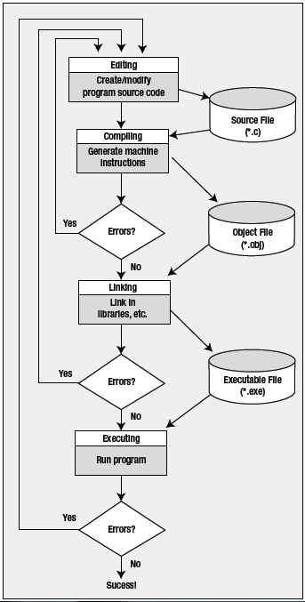
Architectural Diagram

Slide 10
A Simple C Program
/* Filename: First.c
Author: FAST
Description: This program prints the greeting “Hello, World!”
*/
#include <stdio.h>
void main ( void )
{
printf ( “This is class CS118!\n” ) ;
getch( ) ;
}

Slide 11
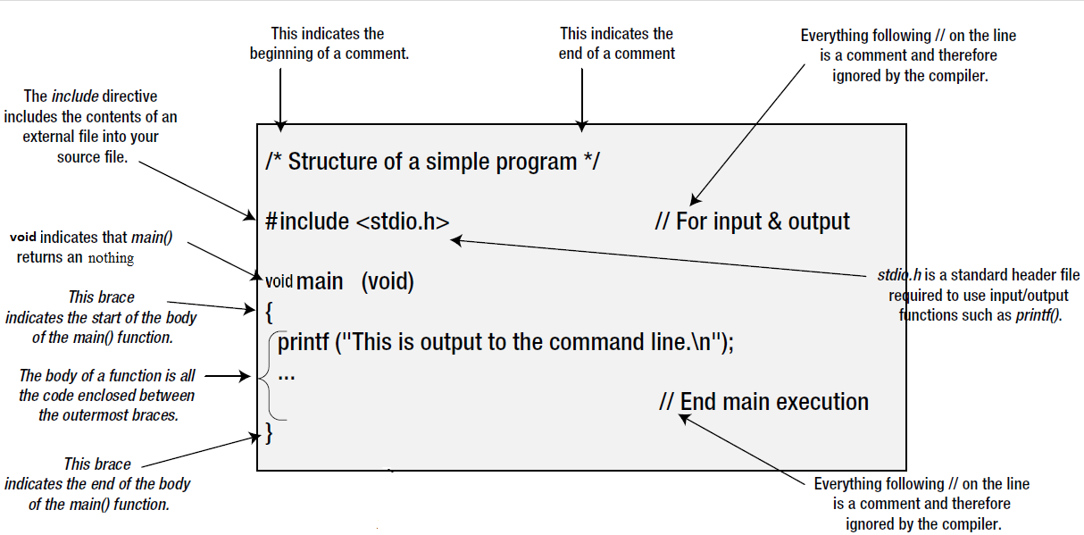
Anatomy of a C Program

Slide 12
Running gcc’s manually
Preprocessing: adding stdio.h contents
gcc first.c
gcc –E frist.c
Compilation: Converting into assemble code
gcc –S first.c
Assembling: assembly code to machine code
gcc –c first.s
hexdump first.o
Linking: linking with library files & producing .exe file
gcc –o myfirst first.o

Slide 13
Program Header Comment
A comment is descriptive text used to help a reader of the program understand its content.
All comments must begin with the characters /* and end with the characters */
These are called comment delimiters
The program header comment always comes first.

Slide 14
Preprocessor Directives
Lines that begin with a # in column 1 are called preprocessor directives (commands).
Example: the #include <stdio.h> directive causes the preprocessor to include a copy of the standard input/output header file stdio.h at this point in the code.
This header file was included because it contains information about the printf ( ) function that is used in this program.

Slide 15
stdio.h
When we write our programs, there are libraries of functions to help us so that we do not have to write the same code over and over.
Some of the functions are very complex and long. Not having to write them ourselves make it easier and faster to write programs.
Using the functions will also make it easier to learn to program!

Slide 16
void main (void)
Every program must have a function called main. This is where program execution begins.
main() is placed in the source code file as the first function for readability.
The reserved word “void” indicates that main() returns nothing.
The parentheses following the reserved word “main” indicate that it is a function.
The reserved word “void” means nothing is there.

Slide 17
The Function Body
A left brace (curly bracket) -- { -- begins the body of every function. A corresponding right brace -- } -- ends the function body.
The style is to place these braces on separate lines in column 1 and to indent the entire function body 3 to 5 spaces.

Slide 18
printf (“Hello, World!\n”);
This line is a C statement.
It is a call to the function printf ( ) with a single argument (parameter), namely the string “Hello, World!\n”.
Even though a string may contain many characters, the string itself should be thought of as a single quantity.
Notice that this line ends with a semicolon. All statements in C end with a semicolon.

Slide 19
getch();
getch() is built-in function
By using this function at end of file, it holds your output screen until you press any character.

Slide 20
Constants and Variables
Constants: A specific alphabetical and/or numeric value that is never changed after it is initially given a value. Storage location given a name. Referred to by the given name.
For Ex. PI - 3.14159
Variables: The value that can be changed. Storage locations are given names. Values of the contents for name variable locations can be changed. Referred to by variable name in the instructions.
For Ex. ShoeCost = 56.00 and
ShoeCost = 35.00

Slide 21
Variables (con’t)
Rules for Naming and using variables
Name a variable according to what it represents. Create as short name as possible but one that clearly represents the variable.
Do not use spaces in a variable name.
Start a variable with a letter.
Do not use dash ( - ) or any symbol that is used as a mathematical operator.
Use the same variable name to represent a specific data.
Be consistent when using upper and lower-case characters.
Use the naming convention specified by the company where you work.

Slide 22
Variables (con’t)
Variable Types:
Type | Memory (byte) | Range
char | 1 | -128 to 127
int | 2 | -32,768 to 32,767
long int | 4 | -2,147,483,648 to 2,147,483,647
float | 4 | 10⁻³⁸ to 10³⁸ 7 digits precisions
double | 8 | 10⁻³⁰⁸ to 10³⁰⁸ 7 digits precisions

Slide 23
Variables (con’t)
To declare a variable in C, do:
var_type list variables;
e.g.
int i, j, k;
float x, y, z;
char ch;

Slide 24
Data Types
Computers must be told the data type of each variable or constant. The data which computer uses are of many different types.
Numeric Data
Numeric data include all types of numbers. It includes subtypes:
Integers are Whole Numbers, includes positive and negative numbers.
Real Numbers are Whole Numbers and Decimal Parts.
Character Data
Alphanumeric data contains of al single-digit numbers, letters and special characters available to the computer.
String Data: more than one character is put together.

Slide 25
Data Types [Cont.]
Logical Data
Consist of two values in the data set - True and False.
Other Data Types
Date Data Type is a number for the date that is the number of days from a certain date in the past.
User Defined Data Types Programmers may define their own data types.

Slide 26
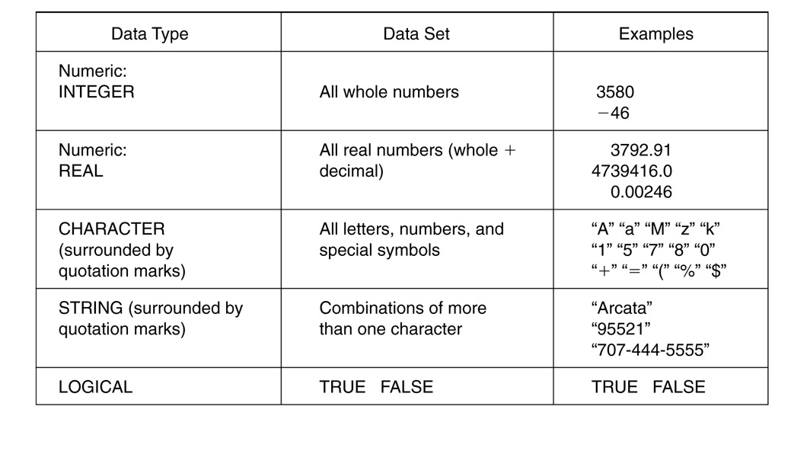
Data Types [Cont.]

Slide 27
printf() Function
C is case sensitive
Syntax:
printf(“Text”);
printf(“Text and format specifier”,Variable name);

Slide 28
printf() Function
C uses formatted output. The printf function has a special formatting character (%) -- a character following this defines a certain format for a variable:
%c – characters
%d – integers
%f – floats
e.g.
printf(“%c %d %f”,ch,i,x);
NOTE: Make sure order of format and variable data types match up.

Slide 29
Format Specifiers
%c Single Character
%s String
%d Signed decimal integer
%f Floating point (decimal notation)
%e Floating point (exponential notation)
%u Unsigned decimal integer
%x Unsigned hexadecimal integer
%o Unsigned octal integer
l prefix used with %d, %u, %x, %o
to specify long integer (e.g. %ld)
%Lf long double

Slide 30
Format Specifiers (con’t)
Example:
void main (void)
{
int event = 5;
char heat = ‘C’;
float time = 27.2589;
printf(“ The winning time in heat %c”, heat);
printf(“ of event %d was %.2f”, event, time);
}

Slide 31
Escape Sequences
The following list shows the common escape sequences:
\n New line
\t Tab
\b Backspace
\r Carriage return
\’ Single quote
\” Double quote
\\ Backslash

Slide 32
scanf() Funtion
Syntax:
scanf (“ format specifier ”, & var_name);
Obtains a value from the user at run time
scanf() uses standard input (usually keyboard)
This scanf statement has two arguments
Format specifier -indicates format of the data
& var_name - location in memory to store variable
& is confusing in beginning – for now, just remember to include it with the variable name in scanf statement
When executing the program the user responds to the scanf statement by typing in a number, then pressing the enter (return) key

Slide 33
scanf() Funtion (con’t)
Example:
#include<stdio.h>
main()
{
int num1,num2,res;
printf(“Enter First Number: “);
scanf(“%d”,&num1);
printf(“Enter Second Number: “);
scanf(“%d”,&num2);
res=num1+num2;
printf(“The sum of two numbers is: %d”, res);
}

Slide 34
Operators
“Operators are words or symbols that
cause a program to do something to variables.”

Slide 35
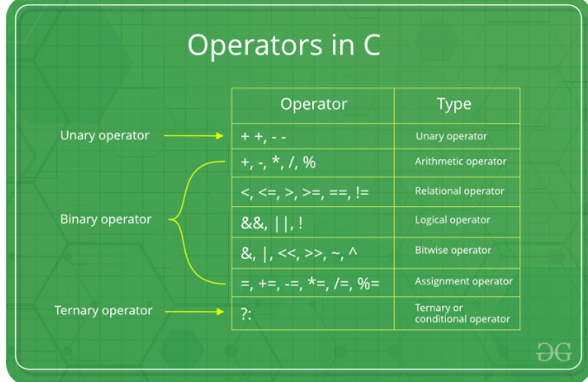
3 Types of operator

Slide 36
Operators
There are may different kinds of operators, but most common of them are as follows:
Arithmetic Operators
Arithmetic Assignment Operators
Unary Operators/ Increment & Decrement Operators
Relational Operators

Slide 37
Arithmetic Operators
These are the operators used to perform arithmetic/mathematical operations on operands. Examples: (+, -, *, /, %,++,–). Arithmetic operator are of two types:
Unary Operators: Operators that operates or works with a single operand are unary operators. For example: (++ , –)
Binary Operators: Operators that operates or works with two operands are binary operators. For example: (+ , – , * , /)

Slide 38
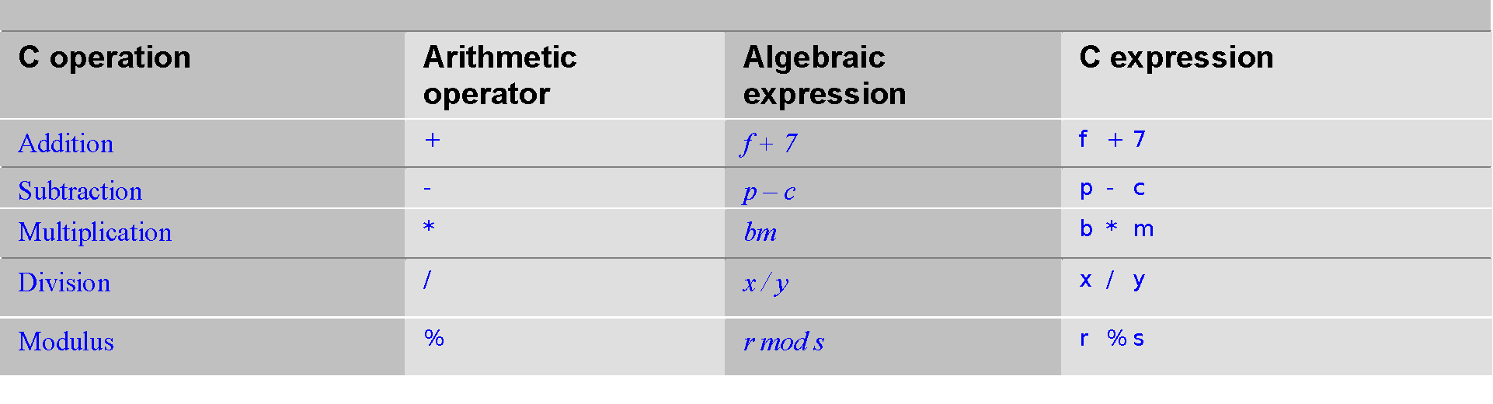
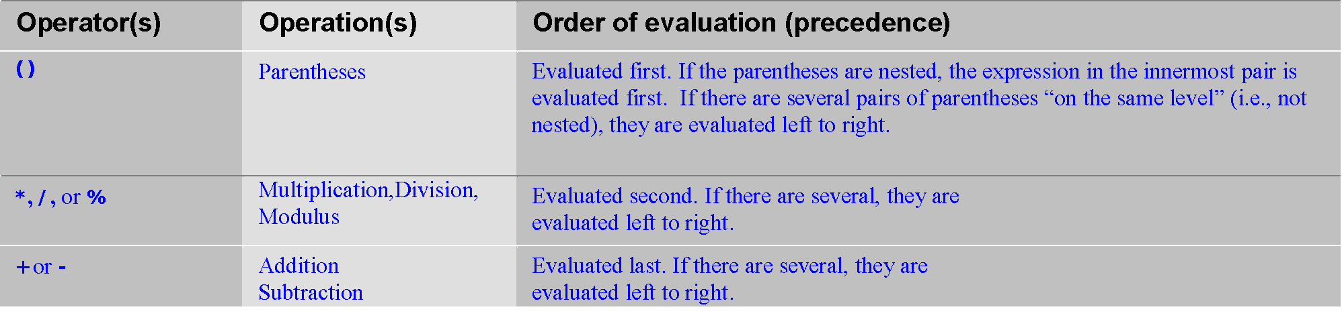
Operators (con’t)
Arithmetic:
Rules of Operator Precendence:

Slide 39
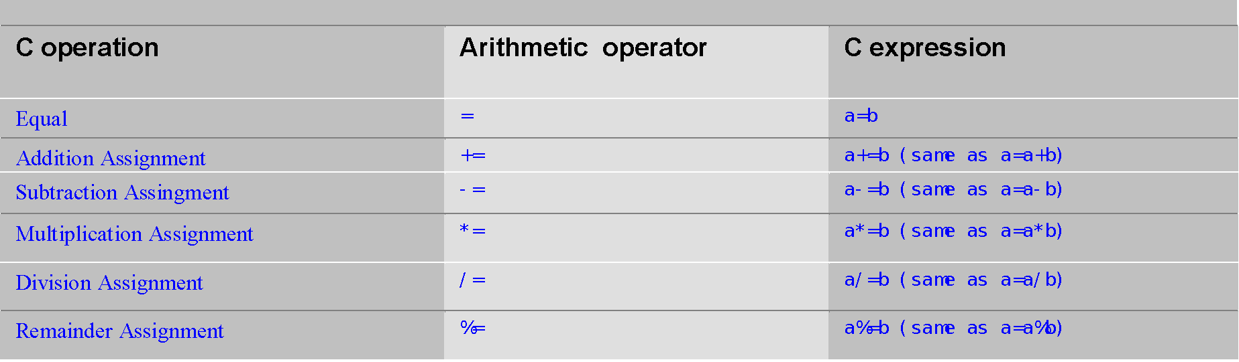
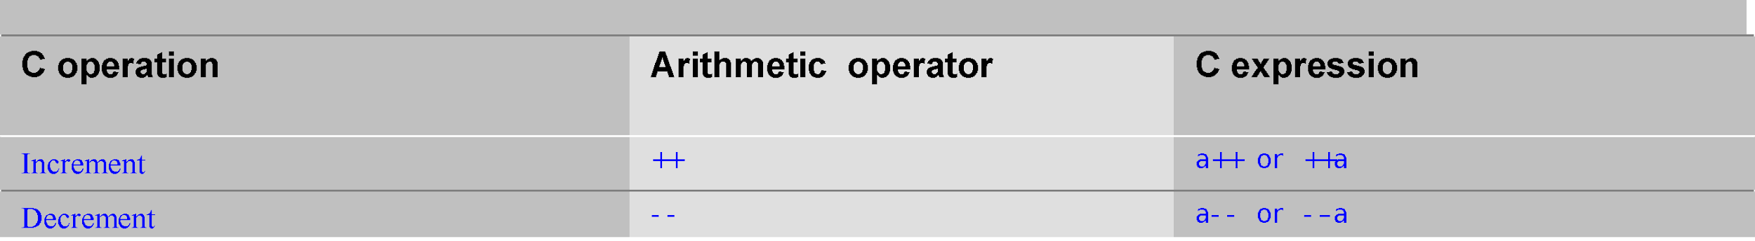
Operators (con’t)
Arithmetic Assignment:
Increment / Decrement:

Slide 40
Output?
#include <stdio.h>
main(){
int a=10;
printf("%d",++a);
}

Slide 41
Operators (con’t)
Equality and Relational:
These are used for comparison of the values of two operands. For example, checking if one operand is equal to the other operand or not, an operand is greater than the other operand or not etc.

Slide 42
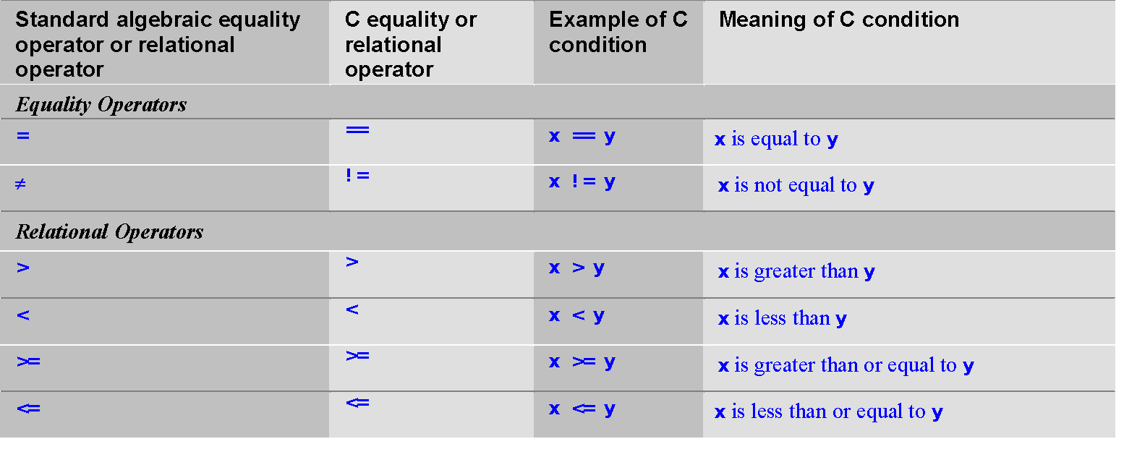
Operators (con’t)
Equality and Relational:

Slide 43
Assignments
Write a program that asks the user to enter two numbers, obtains them from the user and prints their sum, product, difference, quotient and remainder.
Write a program that reads in the radius of a circle and prints the circle’s diameter, circumference and area. Use the constant value 3.14159 for π. Perform each of these calculations inside the printf statement(s) and use the conversion specifier %f.

Slide 44
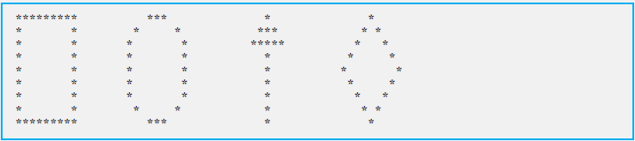
Write a program that prints the numbers 1 to 4 on the same line. Write the program using the following methods.
a) Using one printf statement with no conversion specifiers.
b) Using one printf statement with four conversion specifiers.
c) Using four printf statements.
4. Write a program that prints the following shapes with asterisks.

Slide 45
End of Lecture
ANY QUESTION ????

